Slide 1
OIBSIP DATA ANALYTICS // LEVEL 1
PORTFOLIO PROJECT
Customer Segmentation Analysis
Unlocking Behavioral Patterns and Value Clusters using RFM Modeling & K-Means Unsupervised Machine Learning.
ANALYST
METHODOLOGY
DOMAIN
Soniya Shaik
RFM + K-Means Clustering
E-Commerce & Retail Analytics

Slide 2

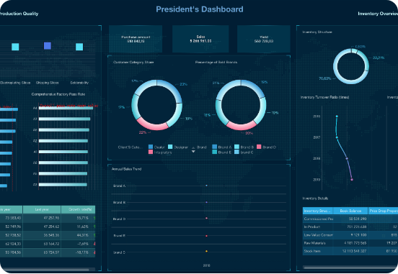
EXECUTIVE SUMMARY
Addressing One-Size-Fits-All Marketing Inefficiencies
The Core Problem
Treating all retail customers uniformly leads to low conversion rates, wasted ad spend, and avoidable customer churn.
The Data Solution
Leverage historical transactional logs to automatically group customers based on actual purchasing behavior.
Strategic Impact
Enable highly targeted campaigns, maximize Customer Lifetime Value (CLV), and optimize marketing ROI.

Slide 3
DATA ARCHITECTURE
End-to-End Data Pipeline & Transformation
01
02
03
04
Data Ingestion
Cleaning & Prep
RFM Extraction
Standardization
Raw transaction log extraction containing InvoiceNo, Quantity, UnitPrice, and CustomerID.
Removed 24.9% missing IDs, canceled orders, and negative quantity anomalies.
Derived Recency (days), Frequency (orders), and Monetary Value (total expenditure).
Log transformation and StandardScaler normalization to handle high skewness.

Slide 4
FEATURE ENGINEERING
RFM Metrics Definition & Calculation
R
F
M
Recency
Frequency
Monetary
Days since last purchase timestamp.
Total count of completed transactions.
Cumulative net spend currency amount.

Slide 5
UNSUPERVISED LEARNING
K-Means Cluster Optimization (k=4)
ELBOW METHOD: WCSS vs CLUSTER COUNT (K)
Elbow Point Identification
Inertia drop flattens significantly after K=4, indicating optimal variance explainability.
Silhouette Score Validation
Confirmed high cluster cohesion and minimal inter-cluster overlap at K=4.
K=2
K=3
K=4*
K=5

Slide 6
CLUSTER ANALYSIS
4 Distinct Customer Segments Identified
SEGMENT 1
SEGMENT 2
SEGMENT 3
SEGMENT 4
Champions
Loyal Customers
At-Risk High Value
Low-Engagement
Recent spenders with highest transaction frequency.
Consistent order patterns with high basket sizes.
High historical spend with no recent activity.
Infrequent purchases with low total monetary value.

Slide 7
QUANTITATIVE PROFILE
Cluster Metrics Comparison Matrix
Segment Cluster | Avg Recency (Days) | Avg Frequency (Orders) | Avg Spend ($) | Share of Revenue
Champions | 12 Days | 18.4 Orders | $8,450 | 48%
Loyal Customers | 34 Days | 7.2 Orders | $2,810 | 29%
At-Risk Spenders | 145 Days | 5.1 Orders | $2,100 | 15%
Low-Engagement | 210 Days | 1.2 Orders | $340 | 8%

Slide 8
STRATEGIC INSIGHT
Revenue Concentration Pareto Distribution
77%
Total business revenue generated by top 2 segments (Champions & Loyal Customers)
Validating the necessity of specialized retention campaigns over broad customer acquisition.

Slide 9
PRESCRIPTIVE STRATEGY
Tailored Marketing Activation Playbook
VIP Loyalty Programs
Win-Back Email Triggers
Provide early product access and exclusive rewards to Champions to lock in retention.
Automate personalized discount incentives for At-Risk high spenders before total churn.
Cross-Sell Recommendations
Low-Cost Ad Retargeting
Deliver tailored product recommendations to Loyal customers based on purchase history.
Minimize paid ad spend on Low-Engagement segment; utilize automated push notifications.

Slide 10



IMPLEMENTATION
Technologies & Data Analytics Stack
Python 3.x
Scikit-Learn
Seaborn & Plotly
Pandas & NumPy data manipulation
K-Means & StandardScaler models
Cluster visualizations & charts

Slide 11

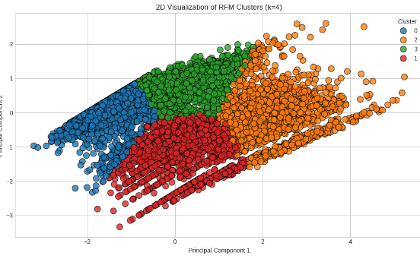
ROADMAP
Next Steps & Algorithmic Scalability
1
Predictive Churn Modeling
Integrate XGBoost supervised models to forecast churn risk probability.
2
Real-Time Pipeline Integration
Deploy model endpoints to automatically assign segment tags to new transactions.
3
CLV Forecasting
Incorporate probabilistic BG/NBD models to estimate long-term monetary lifetime value.

Slide 12

Thank You
Open for Questions & Strategic Discussion
Soniya Shaik
•
OIBSIP Data Analytics Level 1 Project

Slide 13


Image Sources
https://media.finebi.com/strapi/executive_dashboard_7ff806faa0.png
Source: www.fanruan.com
https://jame.scholasticahq.com/article/157562-rfm-based-customer-segmentation-a-pedagogical-case-study-for-marketing-analytics-education/attachment/330427.png
Source: jame.scholasticahq.com

